Slide 1
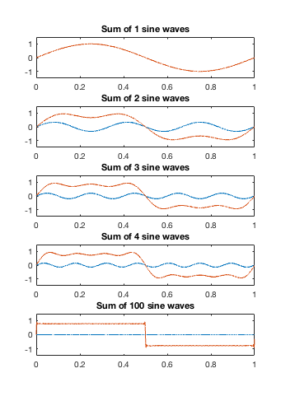
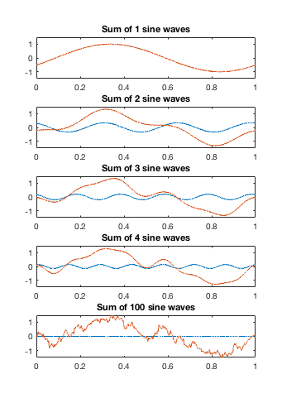

Frequency Representation of Signals
Phase of the basis functions
Now they sound different!

